Slide 1
Controlling MIDI via OSC and applying it to a two-handed layout for a keyboard
Omkar Bhatt
Rohit Rawat
Notes:
Hi everyone. Our project is Controlling MIDI via OSC and applying it to a two-handed layout for a keyboard.

Slide 2
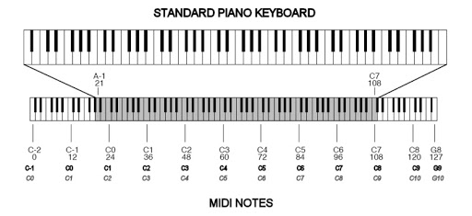
What is MIDI?
Musical Instrument Digital Interface
Communication protocol to connect various electrical musical instruments to a computer for playing, editing and recording
Carries event messages
Note on / Note Off – Pitch and Velocity
MIDI effects: vibrato, pitch bend
Notes:
Reference: https://en.wikipedia.org/wiki/MIDI
Now, what is MIDI?
- Its Musical Intrument Digital Interface
- A communication protocol between musical instruments which help artists play, edit and record their tunes
- It carries MIDI messages, like note on or note off, which is basically pitch played and how how it was pressed, this diagram decomposes a grand piano into MIDI motes

Slide 3
What is OSC?
Open Sound Control
Protocol for networking sound synthesizers with computers
Uses UDP/IP to transport messages
Open-ended, dynamic, URI-style symbolic naming scheme
/inputs/key_on “W”
/outputs/note_on [60 127]
Compatible with multiple open sources
Notes:
Reference: https://en.wikipedia.org/wiki/Open_Sound_Control
OSC is Open Sound Control
It is another protocol, which works on UDP/IP and helps send custom messages over ports, also over internet
This gets very helpful in the time when everyone is working form home
Each message can be built dynamically and is customized

Slide 4
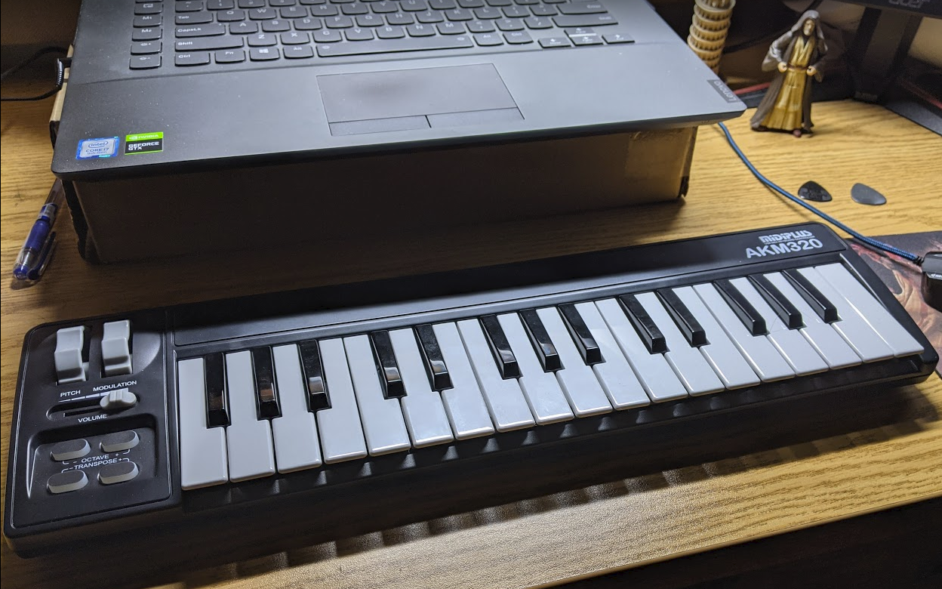
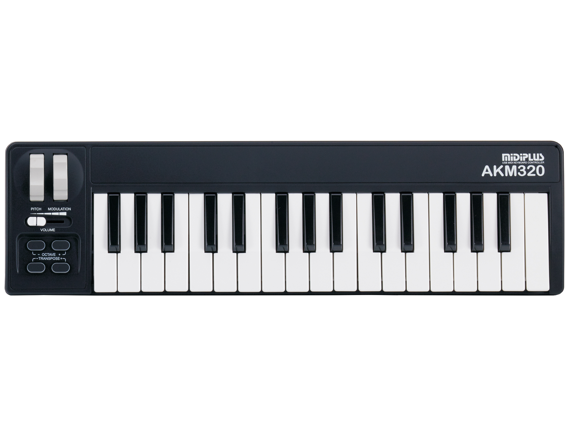
MIDI Controller
MIDI Controller we used for reference
Notes:
Here is the MIDI controller I have which we used as a reference to build our application

Slide 5


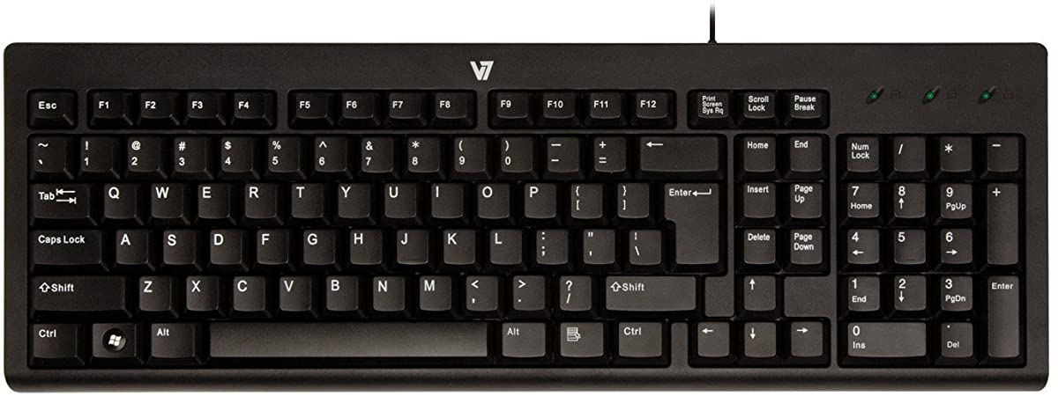
Our Approach + Architecture
Communication (python-osc)
Always async listening
midiKeyboard
User Interface (Max/MSP)
Performs various MIDI effects and operations
Sending Note on/off
Effects:
Network Connection
Port Binding
Receive/send messages between application
Key Press
OSC
Pitch bend
Modulation
Octave
Transpose
MIDI out sound
MIDI format updates
Identify the input type
Make MIDI events
OSC
Return python output in MIDI format
Key Press
Shape Labels:
Tocuhpad movement
I/O
Processing
Notes:
We are using an application called Max to run out front end
In this diagram, orange represents input output, while blue boxes are processing
Max and python
On key press, it sends OSC information to out communication class in python
This class figures out what information is sent and calls appropriate midiKeyboard function from our python class which we developed
It also returns the equivalent MIDI information
MAX updates the UI and plays the MIDI information passed

Slide 6
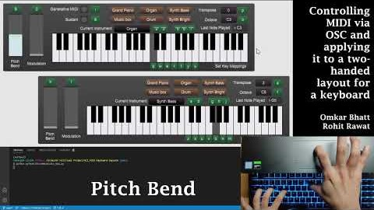
Keyboard Application
Notes:
Youtube Link: https://youtu.be/dWTX7w6zmd4

Slide 7
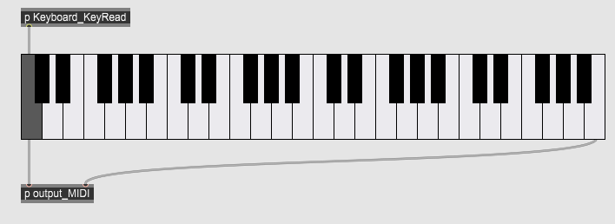
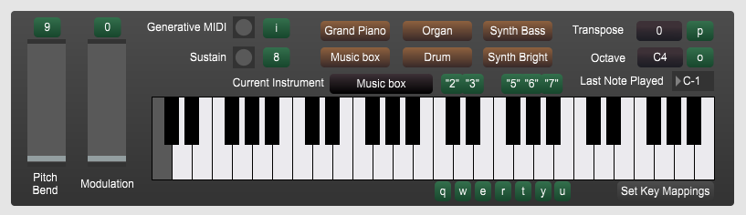
Evaluation
Heuristic Evaluation
Helped improve the UI, and show status of keys pressed
Add more OSC documentation
User Evaluation – [Next Step]
Feedback from user who use a MIDI controller
Feedback from musicians who may/maynot use MIDI controllers
Before Heuristic Evaluation:
After Heuristic Evaluation:
Notes:
We did a heuristic evaluation, which has helped us improve our UI, but we still feel the following could make it easier to use
Documentation for easy python calls using of OSC commands
We also plan to have some of our friends who play regularly give us a user feedback of the application

Slide 8


Thank You
https://youtu.be/dWTX7w6zmd4
https://github.com/OB-0ne/HCI_MIDI-keyboard-layouts

